Slide 1
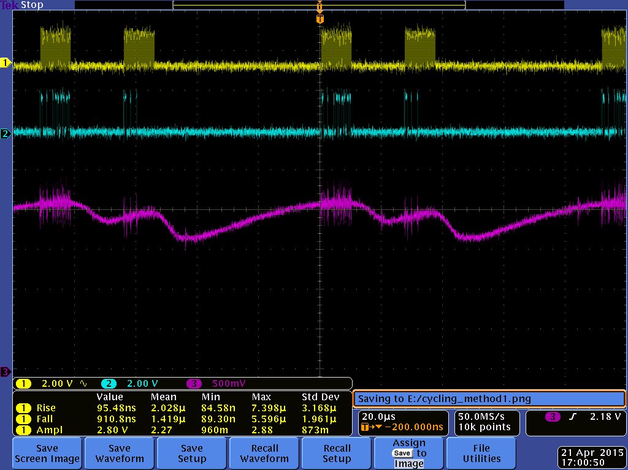
HV Waveform for Method 1 Cycling T7.1.1 4M5CB-19
T = 85μs
Method 1: Repeating
0702013B3B3B (ON)
Wait 17us
070201000000 (OFF)
Wait 50us
17μs
50μs
sclk
*3B3B3B
*000000
*3B3B3B
*000000
data
Cycling Conditions:
VDD = 3.7V
VDDIO = 1.8V
Fosc = 50MHz
Fsclk = 5MHz
CP trim = 40.25V
DVA OFF
Cal OFF
Duty = “25%”
Fcyc = 12kHz
T = room temp.
Vtestout = HV/20
R1,R2,R3 ON
50V
testout
R1,R2,R3 OFF
42V
40V
36V
32V
30V
R1,R2,R3
Beams Fully
Actuated
20V
10V
HV = 0V

Slide 2
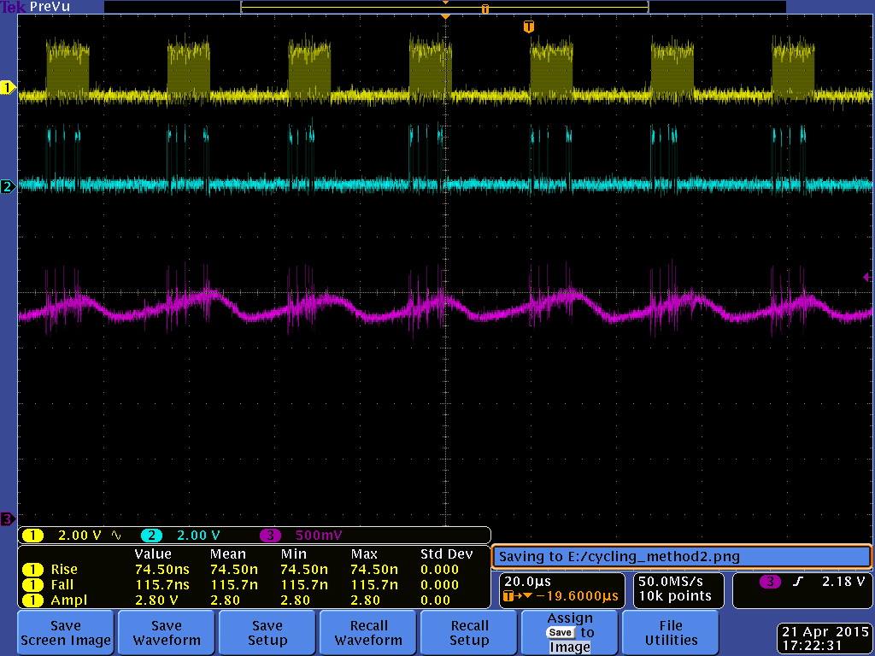
HV Waveform for Method 2 Cycling T7.1.1 4M5CB-19
T = 85μs
Method 2: Repeating
0702013B0000
Wait 19us
070201003B00
Wait 19us
07020100003B
Wait 19us
19μs
sclk
*3B0000
*003B00
*00003B
data
Cycling Conditions:
VDD = 3.7V
VDDIO = 1.8V
Fosc = 50MHz
Fsclk = 5MHz
CP trim = 40.25V
DVA OFF
Cal OFF
Duty = “25%”
Fcyc = 12kHz
T = room temp.
Vtestout = HV/20
R1 ON
R1 OFF
R2 OFF
50V
testout
40V
40V
35V
R3 ON
30V
R3 OFF
R2 ON
20V
R1 Beams
Closed
R2 Beams
Closed
R3 Beams
Closed
10V
HV = 0V

Slide 3
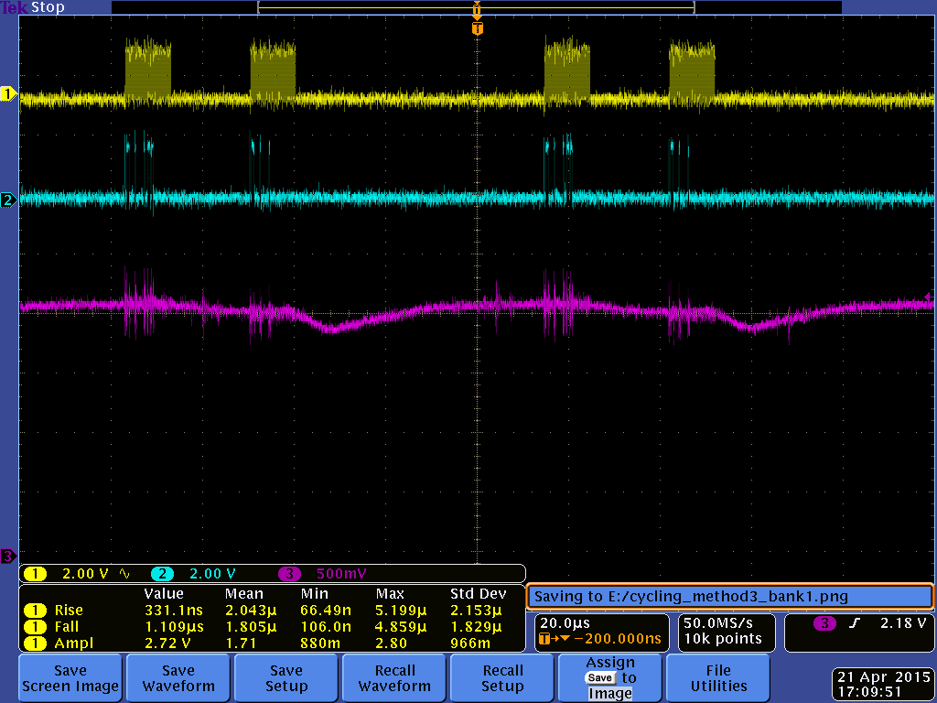
HV Waveform for Method 3 Bank 1 Cycling T7.1.1 4M5CB-19
T = 85μs
Method 3: Repeating
0702013B0000 (ON)
Wait 17us
070201000000 (OFF)
Wait 50us
17μs
50μs
sclk
*3B0000
*000000
data
Cycling Conditions:
VDD = 3.7V
VDDIO = 1.8V
Fosc = 50MHz
Fsclk = 5MHz
CP trim = 40.25V
DVA OFF
Cal OFF
Duty = “25%”
Fcyc = 12kHz
T = room temp.
Vtestout = HV/20
R1 ON
R1 OFF
50V
testout
41V
40V
36V
R1 Beams
Closed
30V
20V
10V
HV = 0V

Slide 4
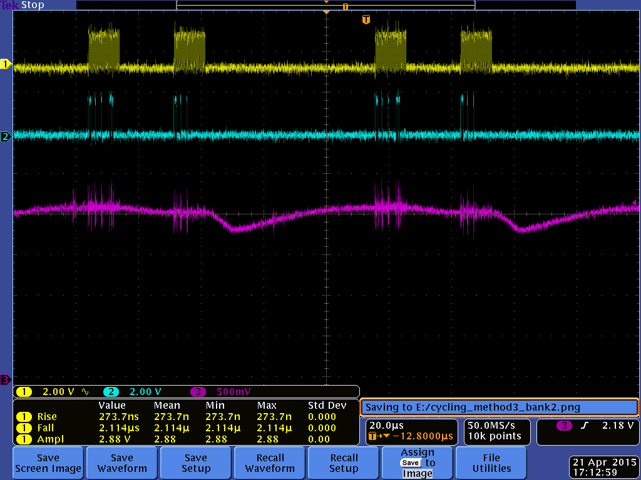
HV Waveform for Method 3 Bank 2 Cycling T7.1.1 4M5CB-19
T = 85μs
Method 3: Repeating
070201003B00 (ON)
Wait 17us
070201000000 (OFF)
Wait 50us
17μs
50μs
sclk
*003B00
*000000
data
Cycling Conditions:
VDD = 3.7V
VDDIO = 1.8V
Fosc = 50MHz
Fsclk = 5MHz
CP trim = 40.25V
DVA OFF
Cal OFF
Duty = “25%”
Fcyc = 12kHz
T = room temp.
Vtestout = HV/20
R2 ON
R2 OFF
50V
testout
41V
40V
36V
R2 Beams
Closed
30V
20V
10V
HV = 0V

Slide 5
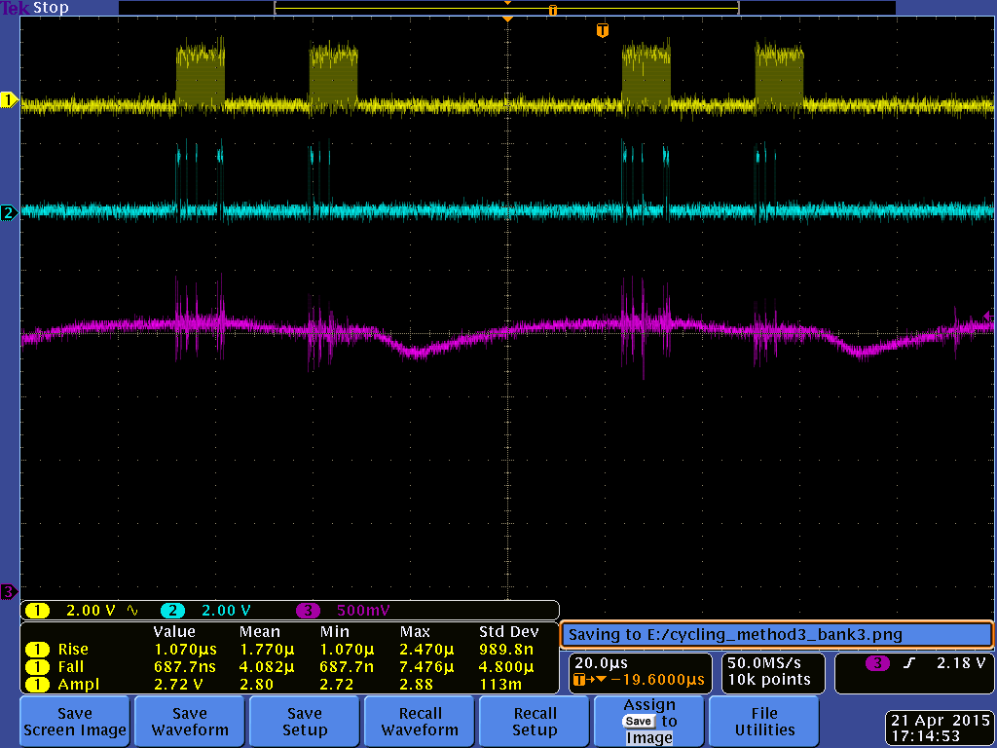
HV Waveform for Method 3 Bank 3 Cycling T7.1.1 4M5CB-19
T = 85μs
Method 3: Repeating
07020100003B (ON)
Wait 17us
070201000000 (OFF)
Wait 50us
17μs
50μs
sclk
*00003B
*000000
data
Cycling Conditions:
VDD = 3.7V
VDDIO = 1.8V
Fosc = 50MHz
Fsclk = 5MHz
CP trim = 40.25V
DVA OFF
Cal OFF
Duty = “25%”
Fcyc = 12kHz
T = room temp.
Vtestout = HV/20
R3 ON
R3 OFF
50V
testout
41V
40V
36V
R3 Beams
Closed
30V
20V
10V
HV = 0V

Slide 6
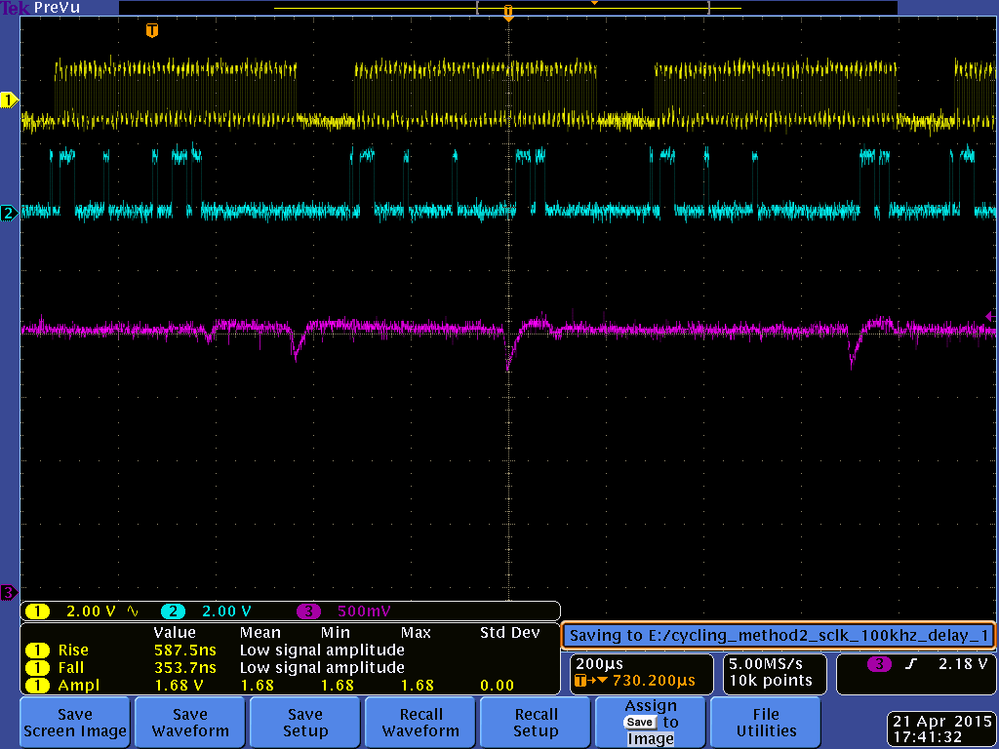
HV Waveform for Method 2-ish Cycling T7.1.1 4M5CB-19
Method 2: Repeating
0702013B0000
Wait 19us
070201003B00
Wait 19us
07020100003B
Wait 19us
100μs
sclk
*3B0000
*003B00
*00003B
data
Cycling Conditions:
VDD = 3.7V
VDDIO = 1.8V
Fosc = 50MHz
Fsclk = 100kHz
CP trim = 40.25V
DVA OFF
Cal OFF
T = room temp.
Vtestout = HV/20
R2 ON
R3 ON
R1 ON
R3 OFF
R1 OFF
R2 OFF
50V
DC coupled
testout
38V
40V
35V
34V
30V
20V
10V
HV = 0V

Slide 7
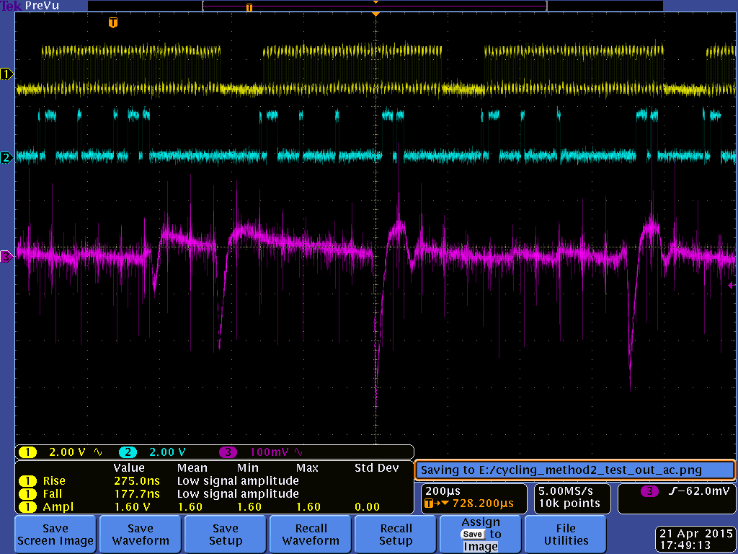
HV Waveform for Method 2-ish Cycling T7.1.1 4M5CB-19
Method 2: Repeating
0702013B0000
Wait 19us
070201003B00
Wait 19us
07020100003B
Wait 19us
100μs
sclk
*3B0000
*003B00
*00003B
data
Cycling Conditions:
VDD = 3.7V
VDDIO = 1.8V
Fosc = 50MHz
Fsclk = 100kHz
CP trim = 40.25V
DVA OFF
Cal OFF
T = room temp.
ΔVtestout = ΔHV/20
R2 ON
R3 ON
R1 ON
R3 OFF
R1 OFF
15kHz
Noise
R2 OFF
AC coupled
testout
ΔHV = 1.6V
ΔHV = 4.4V
ΔHV = 6.4V
ΔHV = 6V
100mV testout = 2V HV

